Slide 1
Other ways of clustering biological sequences

Slide 2
So far
Trees as a way to represent the evolutionary relationship between sequences
We need methods for exploring the space of possible trees
Branch movements!
Different ways of constructing a tree
Distance based methods
UPGMA
Neighbour-joining
….
Character based methods
Maximum parsimony
Maximum likelihood
Bayesian

Slide 3
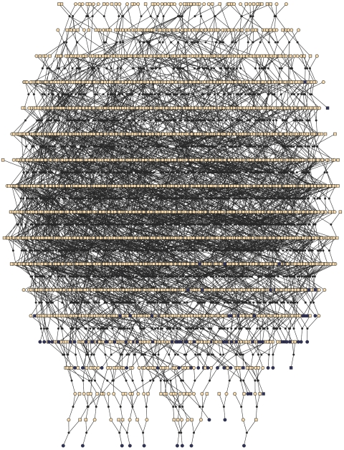
EVOLUTION: IS ALL ABOUT GENEALOGIES
A population is a complex genealogy (but a genealogy anyway!)

Slide 4
EVOLUTION: IS ALL ABOUT GENE GENEALOGIES
Past
Present

Slide 5
EVOLUTION: IS ALL ABOUT GENE GENEALOGIES
Past
All the blue chromosomes of the pedigree come from a single copy (from the grandmother) 2 generations ago
Present

Slide 6
GOING BEYOND WRIGHT-FISHER POPULATION SUBSTRUCTURE AND COALESCENCE
Deme1
Ne
Barrier
Deme2
Demes evolve independently
Time of split

Slide 7
GOING BEYOND WRIGHT-FISHER POPULATION SUBSTRUCTURE AND COALESCENCE
Deme1
Ne
Deme2
Share the same genetic diversity within demes

Slide 8
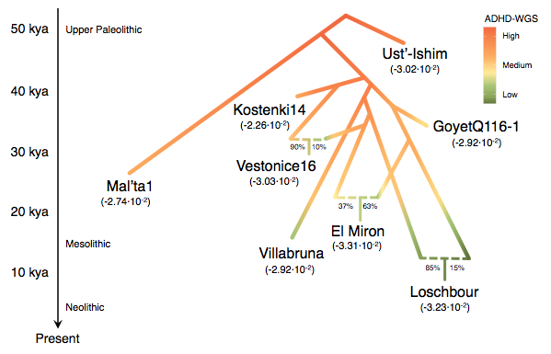
But do we have to think in trees?

Slide 9
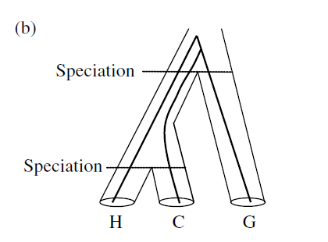
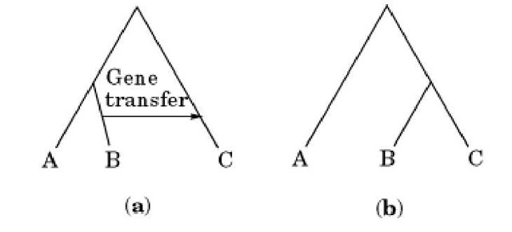
But do we have to think in trees?
Horizontal gene transfer
Recent speciation

Slide 10
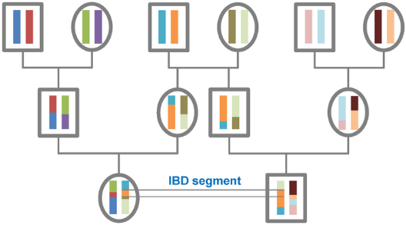
But do we have to think in trees?

Slide 11
But do we have to think in trees?
Looking the gene genealogy of one locus in a pop
Ne

Slide 12
But do we have to think in trees?
Looking the gene genealogy of another (unlinked) locus in the same pop
Ne

Slide 13
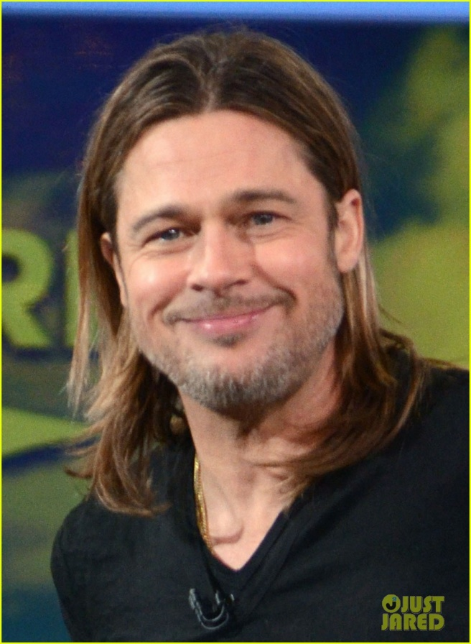
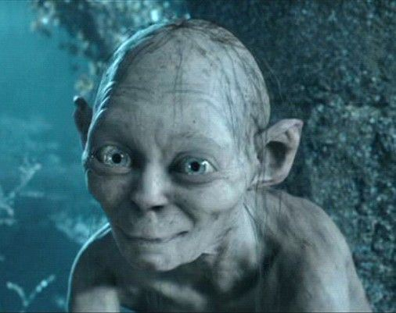
GOING BEYOND WRIGHT-FISHER SELECTION: WORKS BY COMPARISON!
John Lydgate (1440): Odyous of olde been comparisonis, And of comparisonis engendyrd is haterede. (Comparisons are odious)

Slide 14
GOING BEYOND WRIGHT-FISHER SELECTION AND COALESCENCE
Coalescences occur much faster than expected under W-F model before the mutation is fixed
The tree is not independent of the mutations. It becomes associated to the mutation under selection
After fixation, we go back to the W-F model under neutrality

Slide 15
Coalescence under strong selection
Reduced amount of diversity
Large number of private mutations
The shape of the tree is compressed
Large number of coalescence events in few generations
Notes:
Introduce example of cancer

Slide 16
Which is the purpose of a tree? (What do we want to represent when we construct a tree from a sequence?)

Slide 17

Is there any other way of reducing the dimensionality of the data to highlight the inner structure represented by the sequences? And of clustering?
OTU | 1 | 2 | 3 | 4 | … | n
a | A | T | A | T | A | C
b | A | T | C | T | A | C
c | G | T | C | G | A | C
d | T | T | C | G | T | C
OTU | V1 | V2 | V3
a
b
c
d

Slide 18
The hard way of getting a meaningful clustering…

Slide 19
The hard way of getting a meaningful clustering…

Slide 20
And here?

Slide 21
Which criteria should we use to cluster points?
Partitional vs hierarchical
Partitional: define groups by iteratively optimizing an objective function. Need of number of prototype points to define what a cluster is. They are also called prototype-based clustering algorithms.
Generative: explain how the data is generated from a probabilistic point of view
Set of rules
Hierarchical: Iteratively clusters points creating a (binary) dendogram. Clusters are automatically defined by setting a threshold in the deepness of the tree.
Bottom-up
Top-down

Slide 22
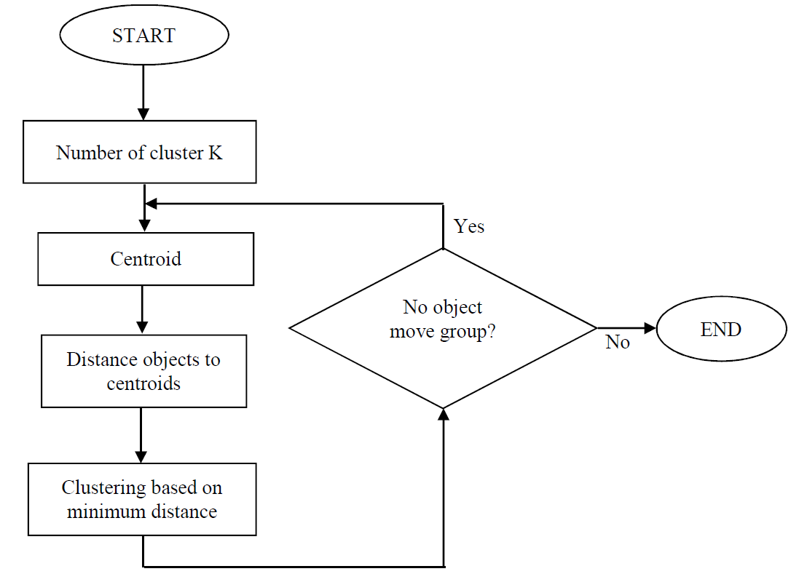
K-means

Slide 23
The K-means approach

Slide 24
The K-means approach
Set the coordinates at random

Slide 25
The K-means approach
Define close neighbours

Slide 26
The K-means approach
Compute the new coordinates as the mean of the points
That fall in each group given previous coordinates

Slide 27
The K-means approach
Set the coordinates at random
Compute the new coordinates as the mean of the points
That fall in each group given previous coordinates

Slide 28
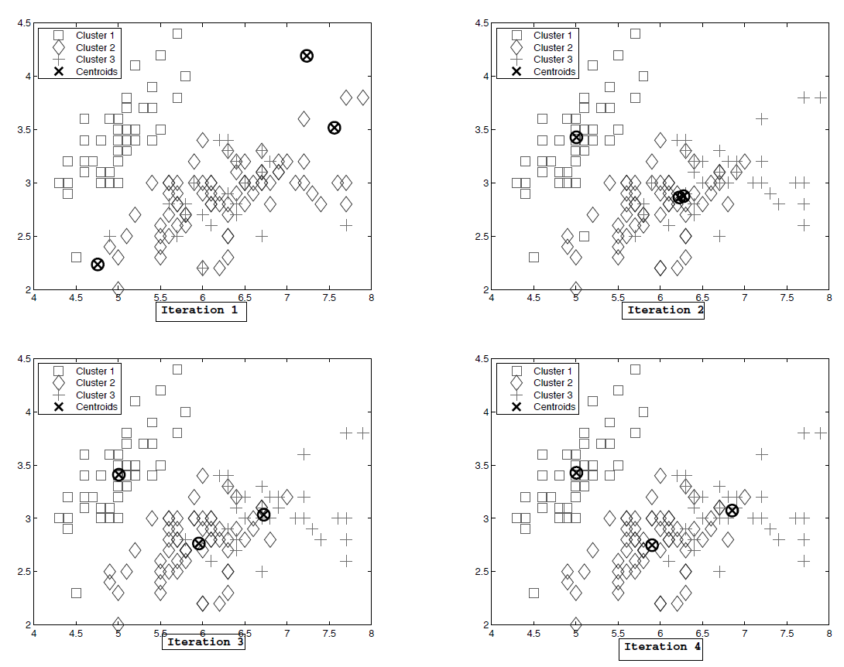
K-means.

Slide 29
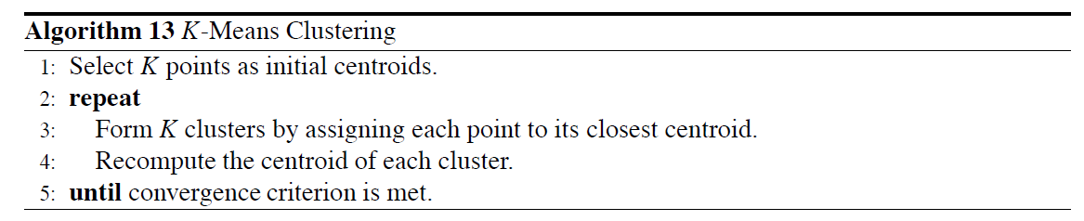
K-means. Pseudocode

Slide 30
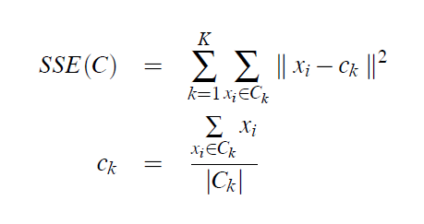
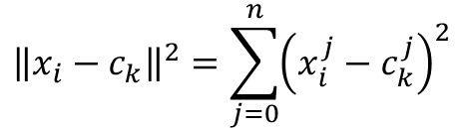
The K-means approach
Objective function to minimize: Sum of Squared Errors (SSE)
For point that has been assigned to that cluster
For each cluster
Centroid of cluster k
$${\left\|x_{i}−c_{k}\right\|}^{2}=\sum_{j=0}^{n}{{\left(x_{i}^{j}−c_{k}^{j}\right)}^{2}}$$
L2 norm is the Euclidean distance

Slide 31
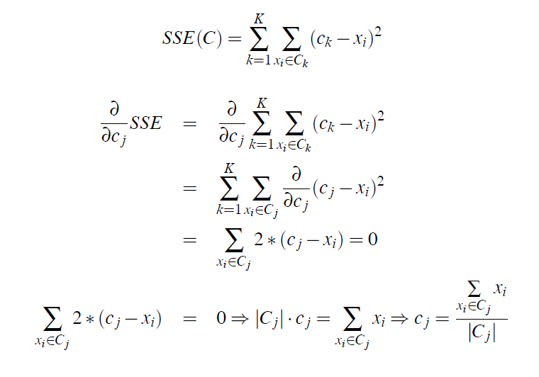
The K-means approach
This means that the centroid of the cluster allows minimizing the distance of assignation of each element that belongs to a cluster to its cluster

Slide 32
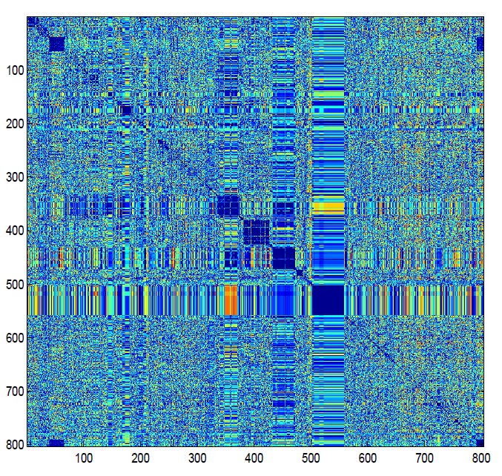
K-means. Pseudocode
Clustering protein sequences
MATRIX OF SIMILARITY BETWEEN SEQUENCES

Slide 33
K-means.
K-means is a greedy algorithm.
Clusters depend not only on the nature of the data, but also on which hyperparameters you use.

Slide 34
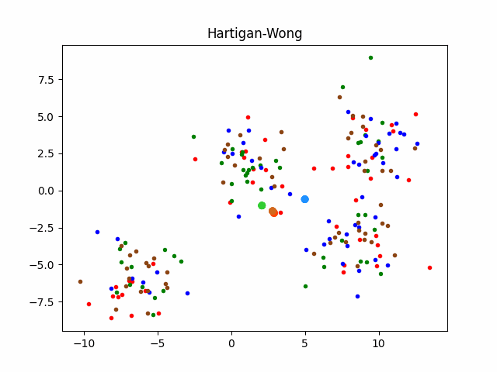
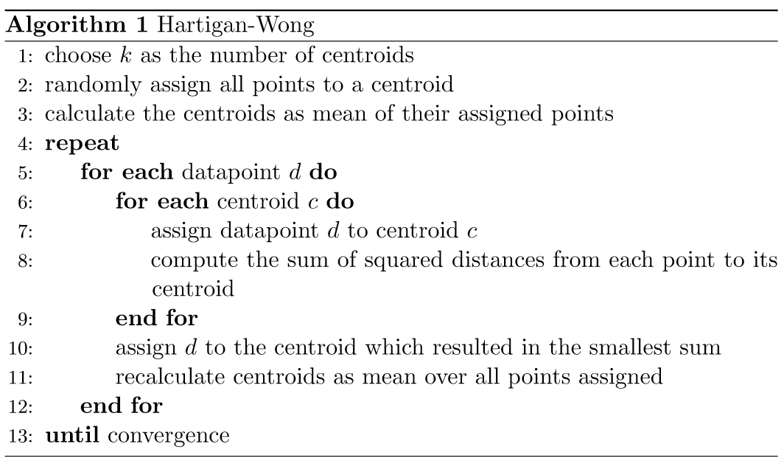
K-means.
Inizialization points
Hartigan and Wong: points which are well separated and have a large number of points within their surrounding multi-dimensional sphere can be good candidates for initial points.

Slide 35
K-means.
Inizialization points
Milligan: Apply first agglomerative hierarchical clustering
K-Means++: First centroid is selected at random. The next centroid selected is the one which is farthest from the currently selected centroid. This selection is decided based on a weighted probability score. The selection is continued until we have K centroids and then K-means clustering is done using these centroids.
Put yours here

Slide 36
The k-means approach
When to stop
As the number of clusters K is changed, the cluster memberships can change in arbitrary ways (things that before were not in the same cluster at k-1, can be in the same cluster at k!)
Which is the optimal number of clusters????

Slide 37
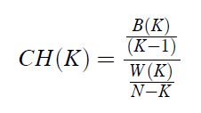
The k-means approach
Calinski–Harabasz Index:
Distance of points Between clusters
Distance of points within clusters
Do we want to maximize or minimize this function?
Number of points
Number of clusters

Slide 38
The k-means approach
A silhouette approach

Slide 39
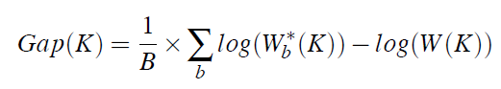
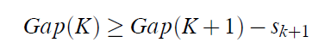
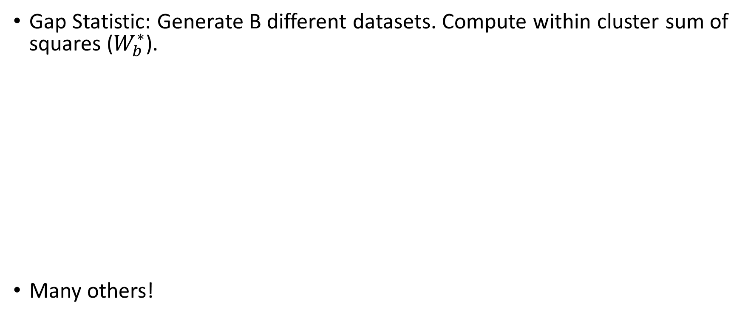
The k-means approach
Gap Statistic: Generate B different datasets. Compute within cluster sum of squares ($W_{b}^{∗}$).
Many others!
Pick the number of clusters K so:

Slide 40
Variations of K means: K-medoids
K-means algorithm is appropriate when the dissimilarity measure is taken to be squared Euclidean distance D(xi, xi0 ).
All of the variables MUST be of the quantitative type.
Squared Euclidean distance places the highest influence on the largest distances.
Lack robustness against outliers that produce very large distances.

Slide 41
K-medoids
The algorithm can be generalized for use with arbitrarily defined dissimilarities D(xi, xi0 ) by replacing this step by an explicit optimization
Centers for each cluster are restricted to be one of the observations assigned to the cluster

Slide 42
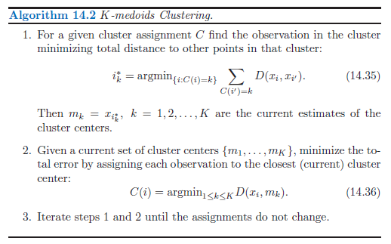
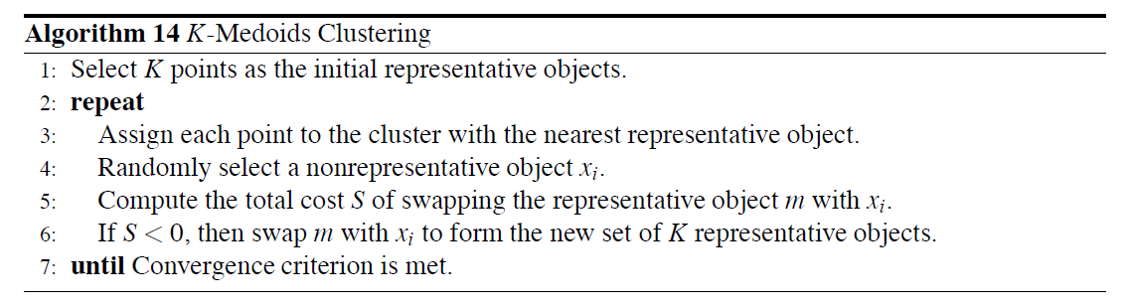
K-medoids. Pseudocode

Slide 43
Other applications based on k-means approach
Identify the function of a protein based on its sequence.
Similarity of protein domains should be associated to function.
What is similarity?
How to do it?

Slide 44
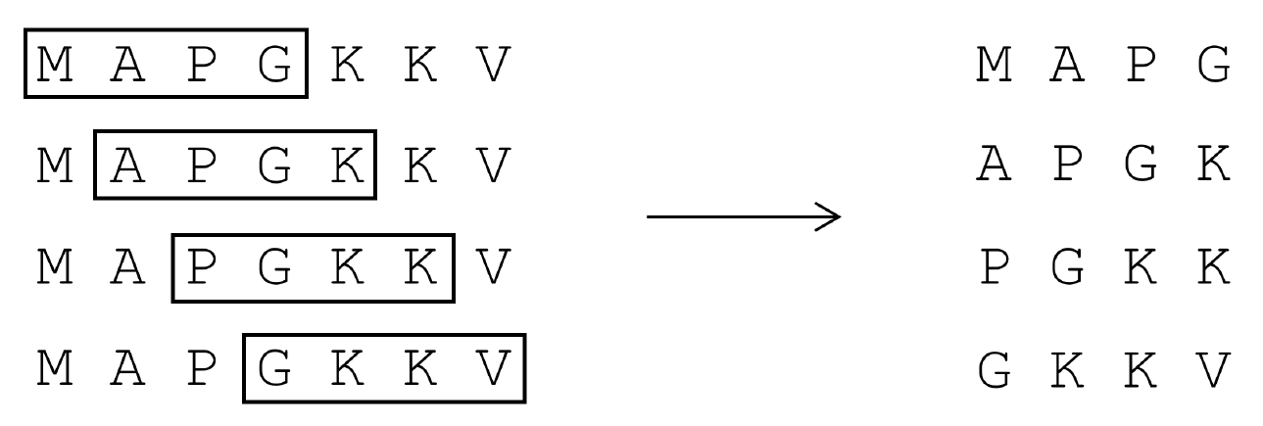
Other applications based on k-means approach
PROTEIN SEQUENCE

Slide 45
Other applications based on k-means approach
WINDOW

Slide 46
Other applications based on k-means approach
MOVE THE WINDOW

Slide 47
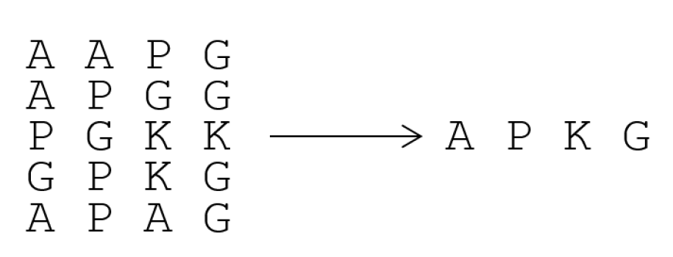
Other applications based on k-means approach
APPLY K-MEANS TO IDENTIFY CENTROID WINDOWS

Slide 48
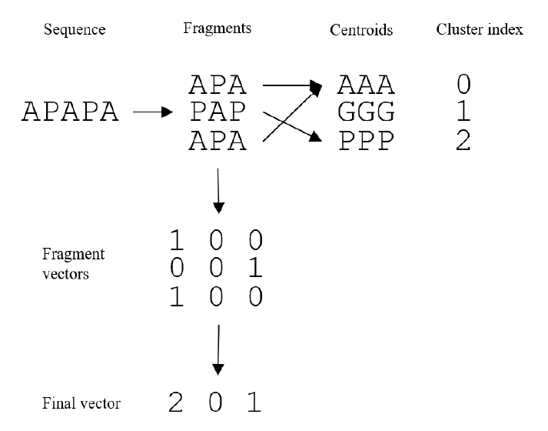
Other applications based on k-means approach
ENCODE THE PROTEIN SEQUENCE INTO A SEQUENCE OF CLUSTER INDEXES
This vector can then be used to perform a clustering, train a model on functional prediction, etc

Slide 49
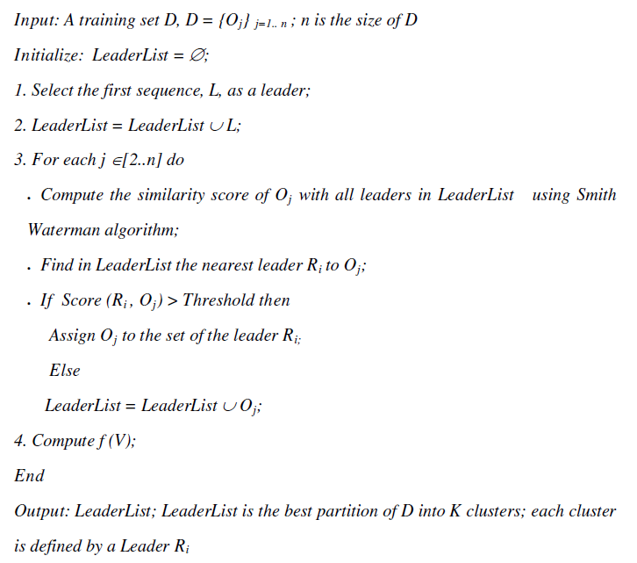
LEADER algorithm

Slide 50
Hierarchical clustering
Agglomerative (bottom-up) and divisive (top-down).
With both paradigms there are N − 1 levels in the hierarchy.
All agglomerative and some divisive methods (when viewed bottom-up) possess a monotonicity property. That is, the dissimilarity between merged clusters is monotone increasing with the level of the merger. Thus the binary tree can be plotted so that the height of each node is proportional to the value of the intergroup dissimilarity between its two daughters. The terminal nodes representing individual observations are all plotted at zero height.

Slide 51
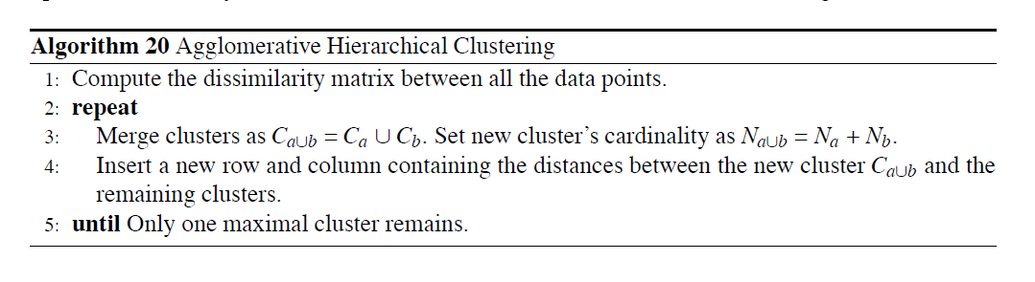
Hierarchical clustering
Agglomerative (bottom-up).

Slide 52
Hierarchical clustering
Agglomerative (bottom-up).
Single link clustering. The similarity of two clusters is the similarity between their most similar (nearest neighbor) members. Local similarity-based clustering (allows modelling non-elliptical clusters). Sensitive to OUTLIERS.
Complete link clustering. Measures the similarity of two clusters as the similarity of their most dissimilar members. Generally obtains compact shaped clusters. Sensitive to OUTLIERS.

Slide 53
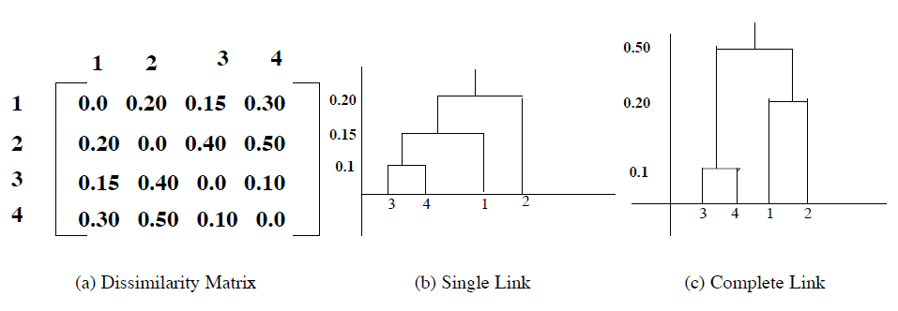
Hierarchical clustering
Data objects
Dissamilirity

Slide 54
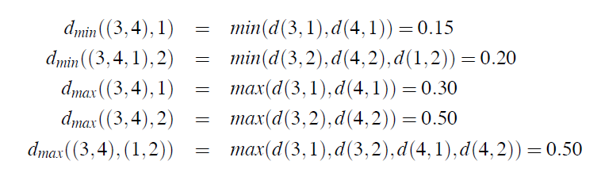
Hierarchical clustering
Data objects
Dissamilirity

Slide 55
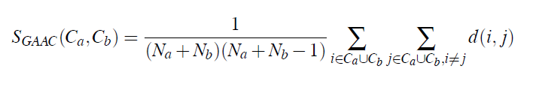
Hierarchical clustering
Group Averaged and Centroid Agglomerative Clustering
Similarity is computed as the average distance between the elements of the clusters
Similarity between cluster a and b
Cluster a
Cluster b

Slide 56
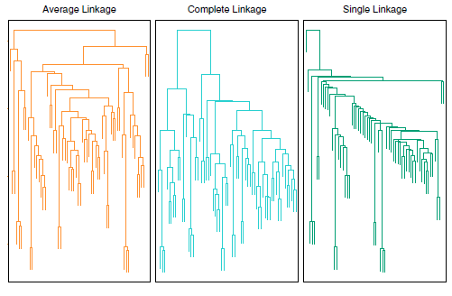
Agglomerative clustering

Slide 57
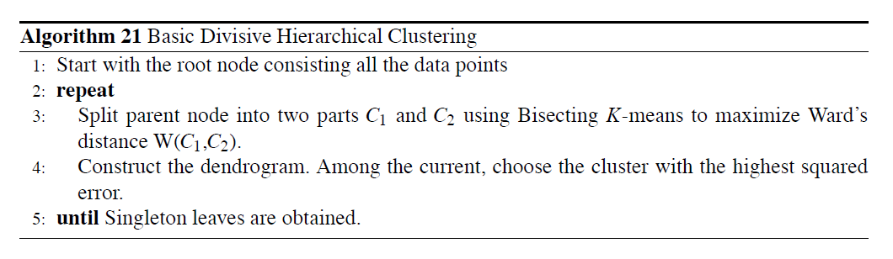
Divisive clustering
begin with the entire data set as a single cluster, and recursively divide one of the existing clusters into two daughter clusters at each iteration in a top-down fashion.

Slide 58
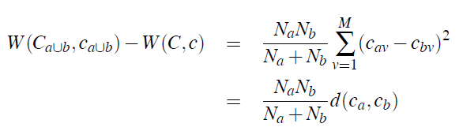
Divisive clustering
Centroid of cluster a for variable v
Splitting criterion: The Ward’s K-means square error:
The greater reduction obtained in the difference in the SSE criterion should reflect the goodness of the split. Gini index (which we will see in next sessions) can be used for handling the nominal data.
Splitting method: The splitting method used to obtain the binary split of the parent node is also critical since it can reduce the time taken for evaluating the Ward’s criterion. The Bisecting K-means approach can be used (with K = 2) to obtain good splits.
Handling noise: Noise points can produce meaningless clusters. A threshold can be used to determine termination.

Slide 59
Hierarchical clustering (Other methods)
CURE (Clustering Using REpresentatives): Each cluster is represented by a set of representative points. The distance between two clusters is calculated by looking at the minimum distance between the representative points chosen.
CHAMELEON is a clustering algorithm which uses graph partitioning methods on the K-nearest neighbor graph of the data. These initial partitions are then used as the seed clusters for the agglomerative hierarchical clustering process.
Self-Organizing Maps (SOM). Come from the field of Artificial Neural Networks. Data points are assigned to their closest centroids using a non-linear function to define the similarity of points.

Slide 60
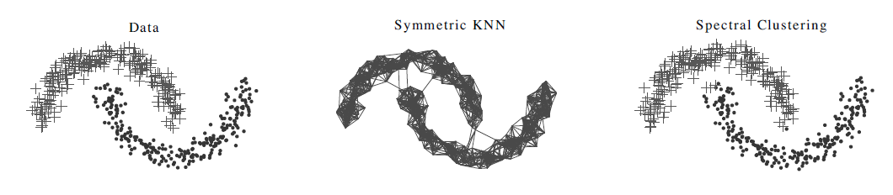
Other clustering methods
Spectral decomposition: Create a graph similarity of points, eigentransformation of the weights of the similarity, detection of clusters

Slide 61
Other clustering methods
MANY MANY MANY OTHERS…

Slide 62
Other ways of reducing the dimensionality
How can we interpret a clustering from an machine learning information point of view?

Slide 63


Slide 64
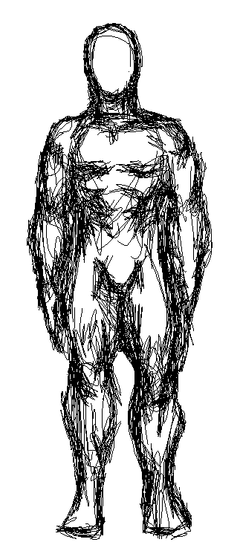
Basics of dimensionality reduction with sequences
K = 4
α4
α3
α2
α1
Dim2
 | snp1 | snp2 | snp3 | snp4 | snp5 | snp6 | … | snpn
I1 | 0 | 1 | 2 | 1 | 0 | 0 |  | 1
I2 | 0 | 0 | 2 | 0 | 0 | 2 |  | 1
I3 | 1 | 1 | 2 | 0 | 0 | 2 |  | 0
I4 | 0 | 1 | 2 | 0 | 1 | 2 |  | 0
I5 | 1 | 1 | 2 | 0 | 1 | 2 |  | 1
…
Im | 2 | 0 | 1 | 0 | 1 | 2 |  | 2
Dim1
AA = 0
AB = 1
BB = 2
Unconstrained dimensions
Constrained dimensions to a certain number (for example, 1)

Slide 65
Basics of dimensionality reduction with sequences
Dim2
Matrix of m OTUs and n polymorphic nucleotides
The algorithm does not understand a nucleotide. It must be transformed into a number.
After running the algorithm, we keep the variables/dimensions explaining most of the variation present in the original matrix.
We try to identify patterns/relationships in this new space.
 | 1 | 2 | 3 | 4 | 5 | 6 | … | n
I1 | 0 | 1 | 1 | 1 | 0 | 0 |  | 1
I2 | 0 | 0 | 1 | 0 | 0 | 1 |  | 1
I3 | 1 | 1 | 1 | 0 | 0 | 1 |  | 0
I4 | 0 | 1 | 1 | 0 | 1 | 1 |  | 0
I5 | 1 | 1 | 1 | 0 | 1 | 0 |  | 1
…
Im | 0 | 0 | 1 | 0 | 1 | 0 |  | 0
Dim1
A = 0
D = 1

Slide 66
Basics of dimensionality reduction with sequences
Dim2
All variables must be in the same “units”, otherwise algorithms will give more weight to variables with greater variances
 | 1 | 2 | 3 | 4 | 5 | 6 | … | n
I1 | 0 | 1 | 1 | 1 | 0 | 0 |  | 1
I2 | 0 | 0 | 1 | 0 | 0 | 1 |  | 1
I3 | 1 | 1 | 1 | 0 | 0 | 1 |  | 0
I4 | 0 | 1 | 1 | 0 | 1 | 1 |  | 0
I5 | 1 | 1 | 1 | 0 | 1 | 0 |  | 1
…
Im | 0 | 0 | 1 | 0 | 1 | 0 |  | 0
Dim1
m1
sd1
m2
sd2
m3
sd3
m4
sd4
m5
sd5
m6
sd6
m7
sd7

Slide 67
Basics of dimensionality reduction with sequences
Dim2
All variables must be in the same “units”
 | 1 | 2 | 3 | 4 | 5 | 6 | … | n
I1 | (0-m1)/sd1 | (1-m2)/sd2 | (1-m3)/sd
I2
I3
I4
I5
…
Im
Dim1

Slide 68
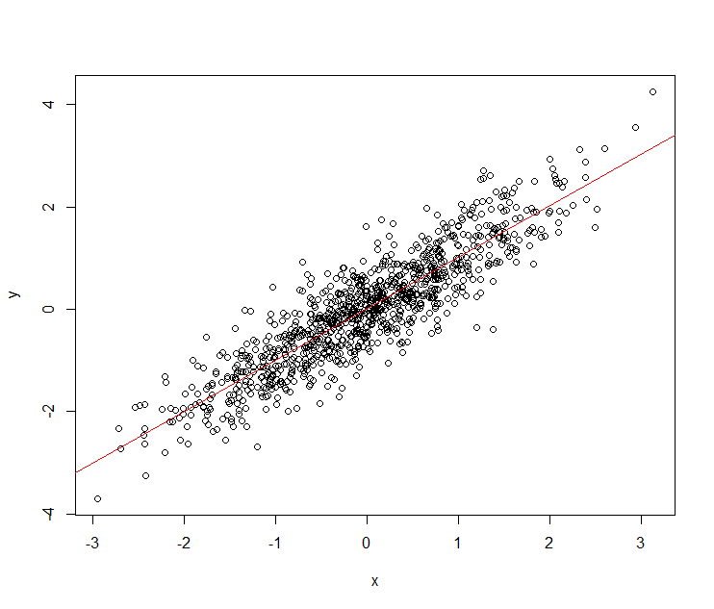
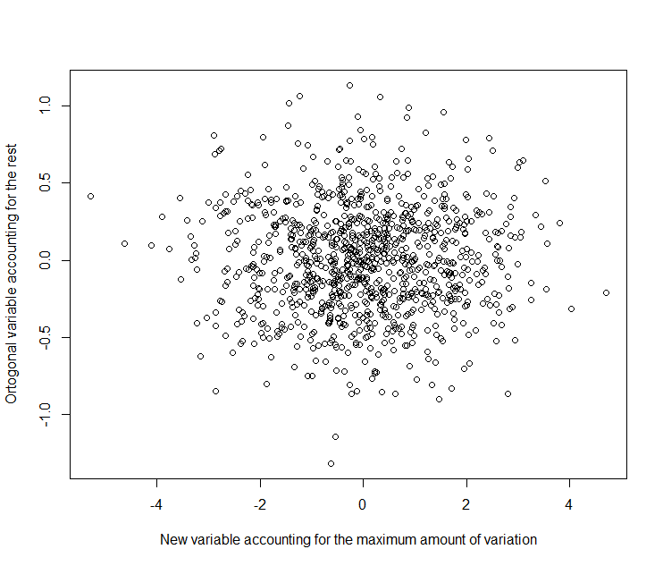
Which is the principle of a dimensionality reduction?
Minimum axis of differentiation
Maximum axis of differentiation

Slide 69
Some methods for dimensionality reduction
Continuous variables
Principal Component Analysis (PCA)
Coordinate analysis (PCoA)/classical multidimensional scaling (MDS)
…
Categorical variables
Categorical PCA
Non-metric MDS
…
Variables must add to a value (i.e. percentage)
Correspondence analysis
Logratio analysis/Weighted PCA
…
Non-linear PCA / Autoencoders
tSNE
…

Slide 70
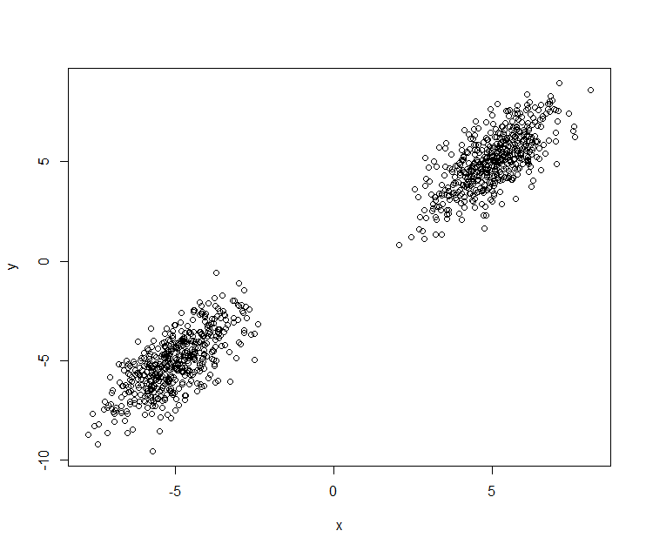
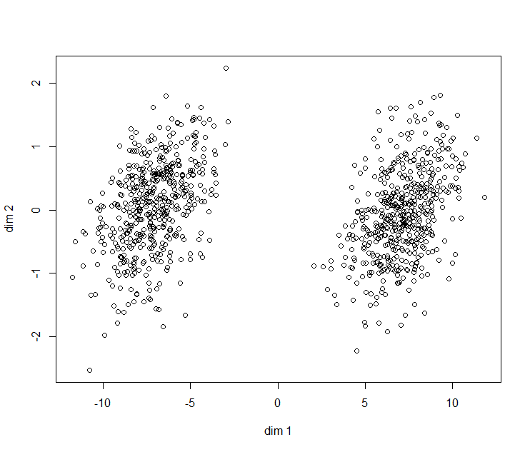
A coordinate analysis approach (classical multidimensional scaling)
$D_{i,j}={\left\|x\right\|}_{2}= w_{dim1}{\left({dim1}_{i}−{dim1}_{j}\right)}^{2}$+$w_{dim2}{\left({dim2}_{i}−{dim2}_{j}\right)}^{2}$
$$w_{dim1}>w_{dim2}$$
 | I1 | I2 | … | In
I1 | 0
I2 | D2,1 | 0
… | D…,1 | D…,2 | 0
In | Dn,1 | Dn,2 | Dn,… | 0
$d_{i,j}={\left\|x\right\|}_{2}= {\left(x_{i}−x_{j}\right)}^{2}$+${\left(y_{i}−y_{j}\right)}^{2}$

Slide 71
Many other distances can be used!

Slide 72
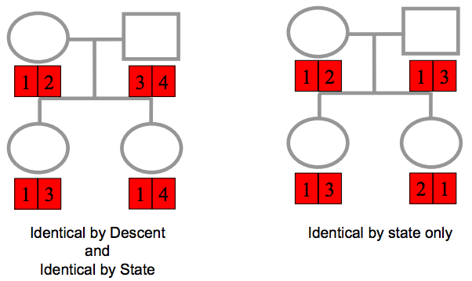
Genetic distances
Between individuals
Between populations
Fst family
Nei's standard genetic distance
Nei's minimum genetic distance
Informativeness of ancestry
…

Slide 73
A principal coordinate analysis (PCoA) approach Some algebra (sigh!)
Identity matrix
A is 3 X 2 matrix
Orthonormal matrix
Multiplication by a scalar
Transpose A
Norm of a vector
Add A and B
Matrix multiplication
Vector multiplication
Trace
Norm of a vector

Slide 74
Some algebra (sigh! Sigh!)

Slide 75
Algebra derivation of PCoA (multidimensional classical scaling)

Slide 76
Algebra derivation of PCoA (classical multidimensional scaling)

Slide 77
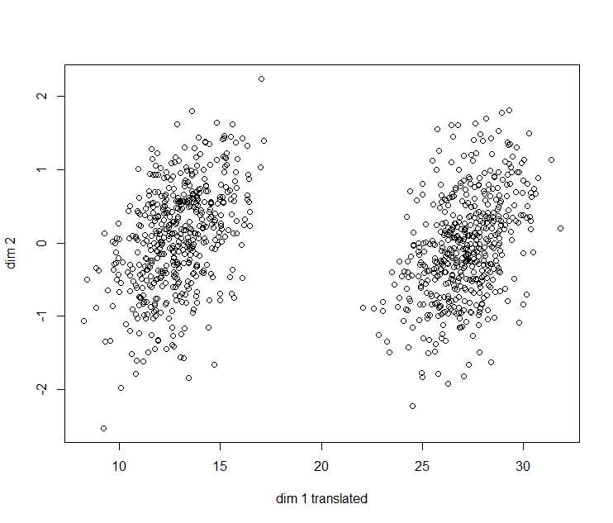
A coordinate analysis approach Step by Step
 | I1 | I2 | … | In
I1 | 0
I2 | D2,1 | 0
… | D…,1 | D…,2 | 0
In | Dn,1 | Dn,2 | Dn,… | 0
The same distance matrix can produce infinite solutions…
We will center the solution by
setting that the sum of dim1 = 0 and sum dim2 = 0.

Slide 78
The algorithm

Slide 79
Interpretation of results
More weight
Positive
Eigenvalues
(n-1)
Eigenvector (n-1)
Less weight

Slide 80
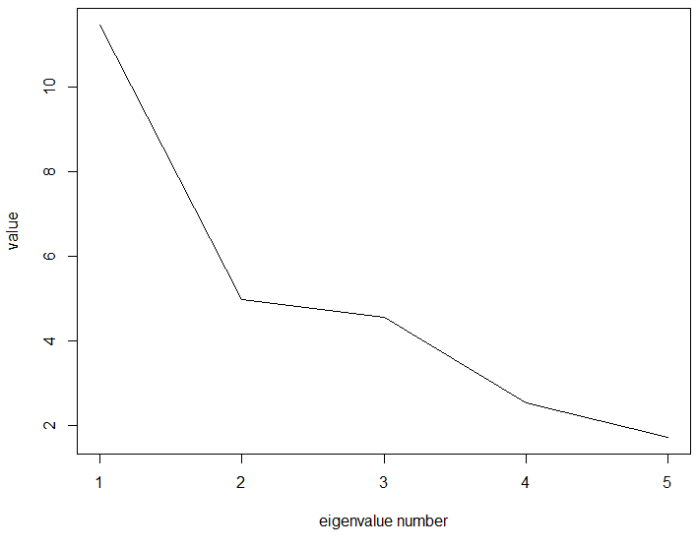
Interpretation of results

Slide 81
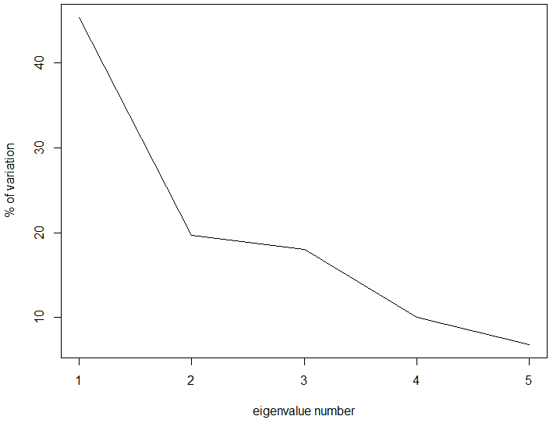
Interpretation of results
83%

Slide 82
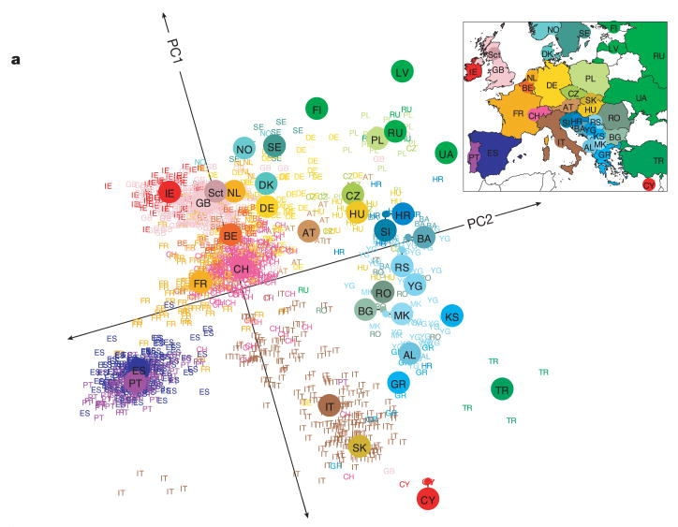
Example: European genetic substructure
Novembre et al 2007 Nature
Orthogonal new variables

Slide 83
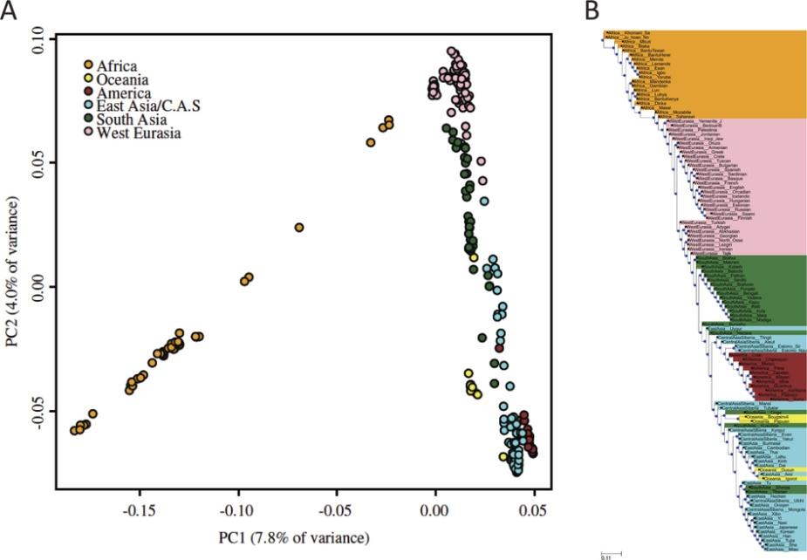
Example: worldwide populations

Slide 84
Another way of computing the Principal Coordinate analysis. Error between the real distance matrix and the distance matrix computed with the new coordinates
=
Raw stress
=

Slide 85
SMACOF algorithm
A working example
=

Slide 86
More complex distance based transformations. tSNE (Stochastic Neighbor Embedding)
The conditional probability that xi would take j as neighbor
Similarity of map point yi to yj

Slide 87
Reduction of dimensionality when the data add to a constant. Correspondence analysis

Slide 88
Reduction of dimensionality when the data add to a constant. Correspondence analysis
Based on Chi-Square statistic

Slide 89
Reduction of dimensionality when the data add to a constant. Correspondence analysis
Based on Chi-Square statistic

Slide 90
Which things are important in clustering sequences?

